Slide 1
MISINFORMATION MATRIX
Based on Carl Sagan’s Demon Haunted World

Slide 2
Summary:
The "Misinformation Matrix" presentation aims to enlighten and engage the audience on the critical issue of misinformation in the digital age. Drawing inspiration from Carl Sagan's wisdom, the presentation explores the complexities of digital narratives, the impact of social media and AI on our perception of truth, and the importance of critical thinking. It concludes with a call to action, urging the audience to foster a culture of truth and skepticism, thereby upholding the legacy of enlightenment and informed discourse in our digital era.

Slide 3
Quote:
“I have a foreboding of an America in my children's or grandchildren's time -- when the United States is a service and information economy; when nearly all the manufacturing industries have slipped away to other countries; when awesome technological powers are in the hands of a very few, and no one representing the public interest can even gr
asp the issues; when the people have lost the ability to set their own agendas or knowledgeably question those in authority; when, clutching our crystals and nervously consulting our horoscopes, our critical faculties in decline, unable to distinguish between what feels good and what's true, we slide, almost without noticing, back into superstition and darkness...
The dumbing down of American is most evident in the slow decay of substantive content in the enormously influential media, the 30 second sound bites (now down to 10 seconds or less), lowest common denominator programming, credulous presentations on pseudoscience and superstition, but especially a kind of celebration of ignorance”
― Carl Sagan, The Demon-Haunted World: Science as a Candle in the Dark

Slide 4
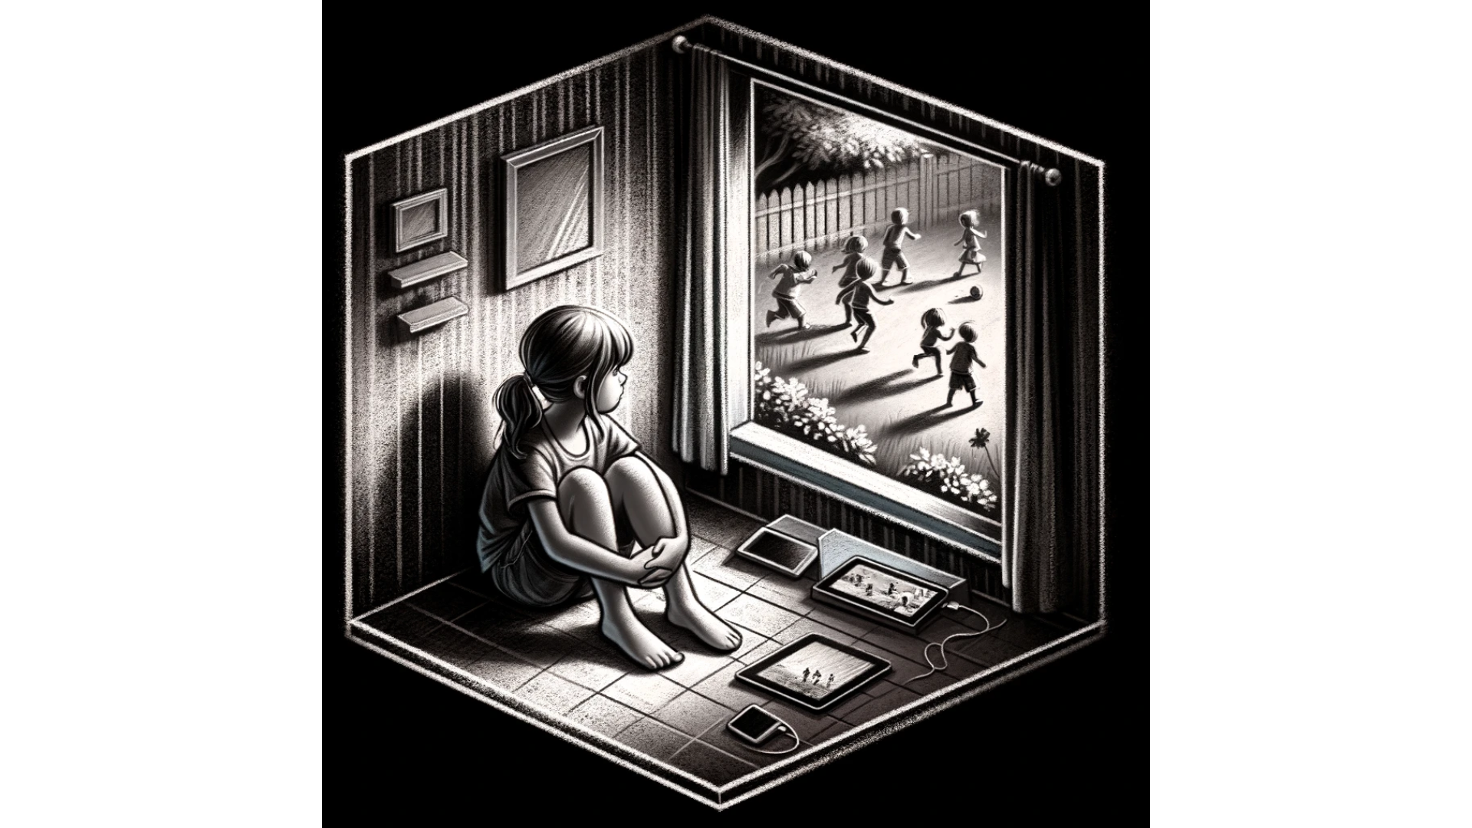
The Digital Disconnect

Slide 5
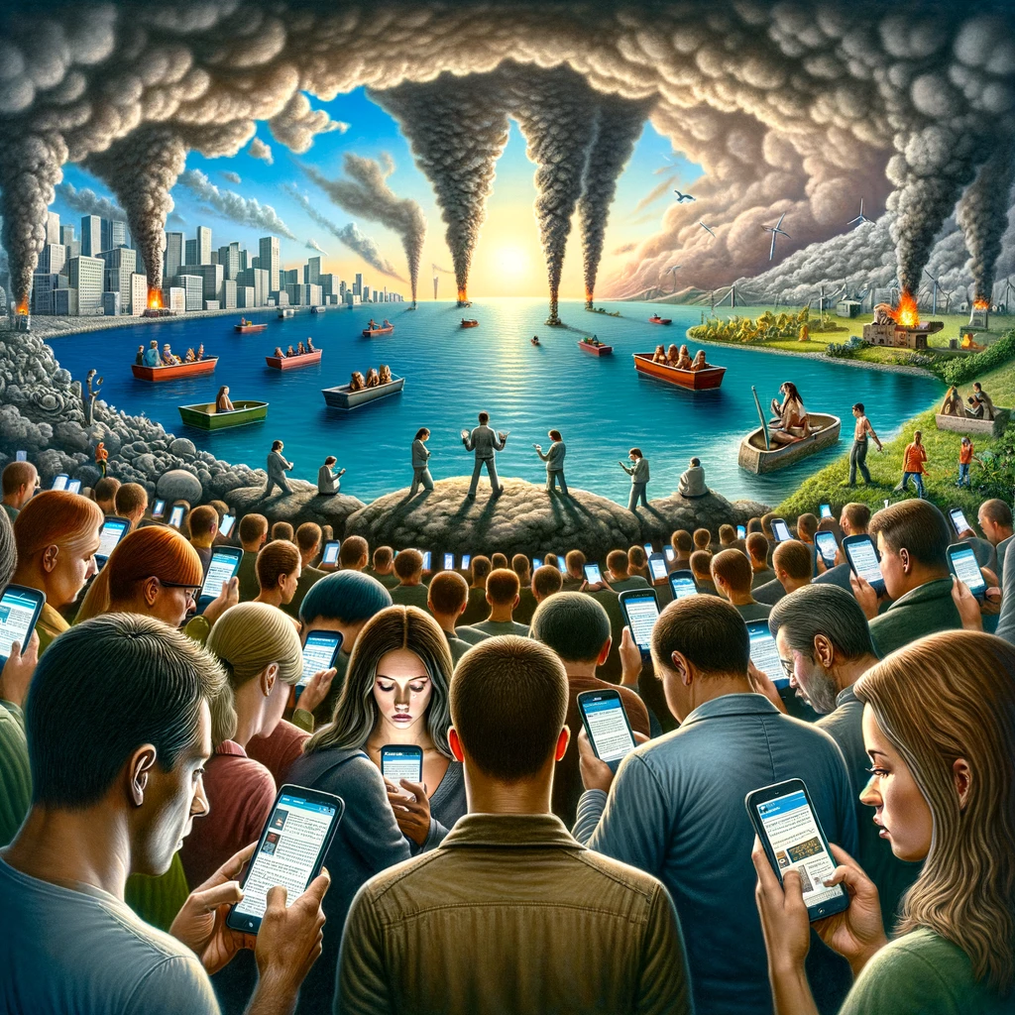
The Allure of Digital Misinformation

Slide 6
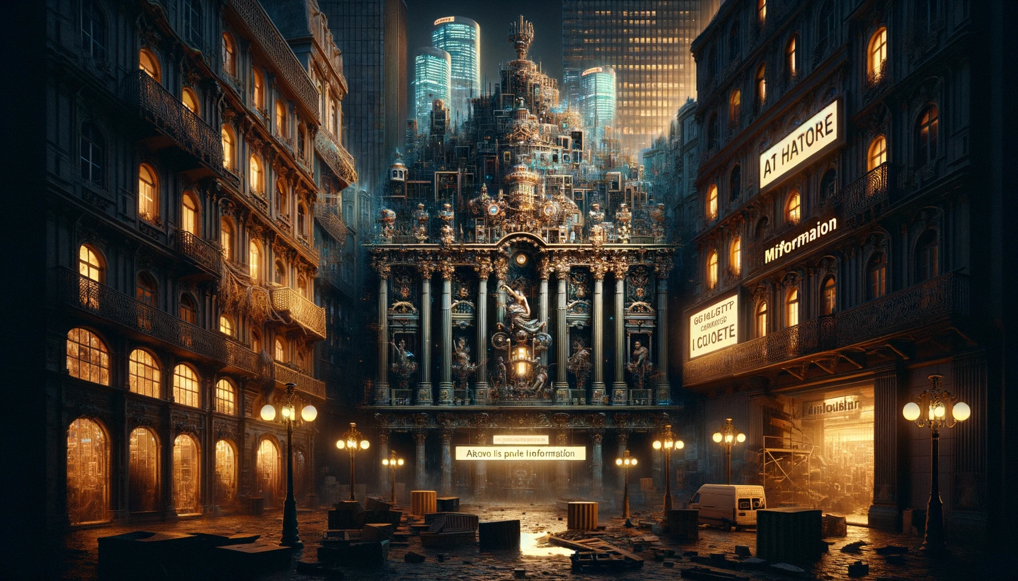
Artistic Representations of Misinformation

Slide 7
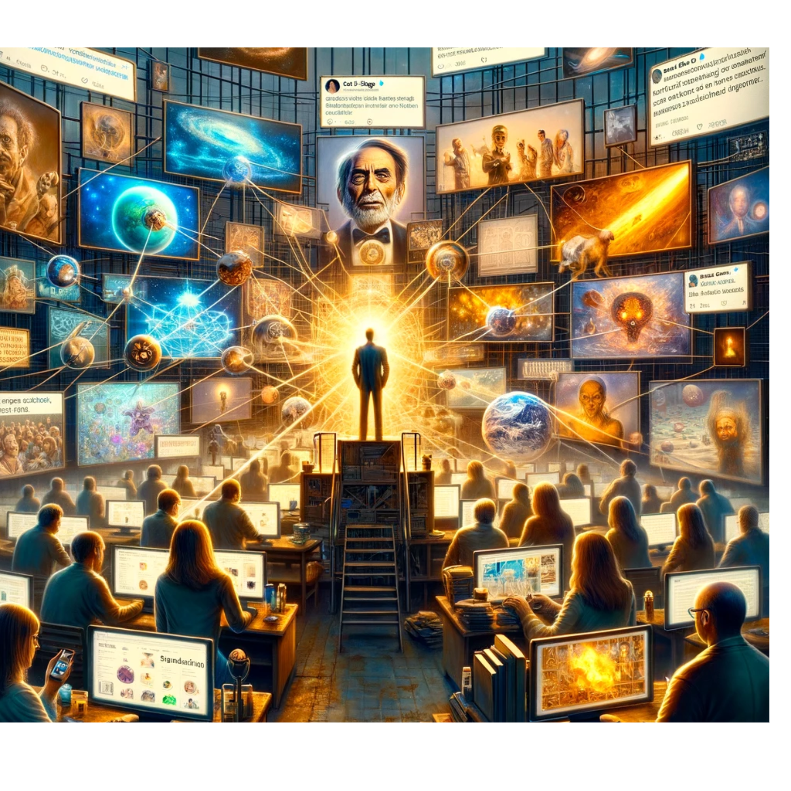
The Role of AI and Misinformation

Slide 8
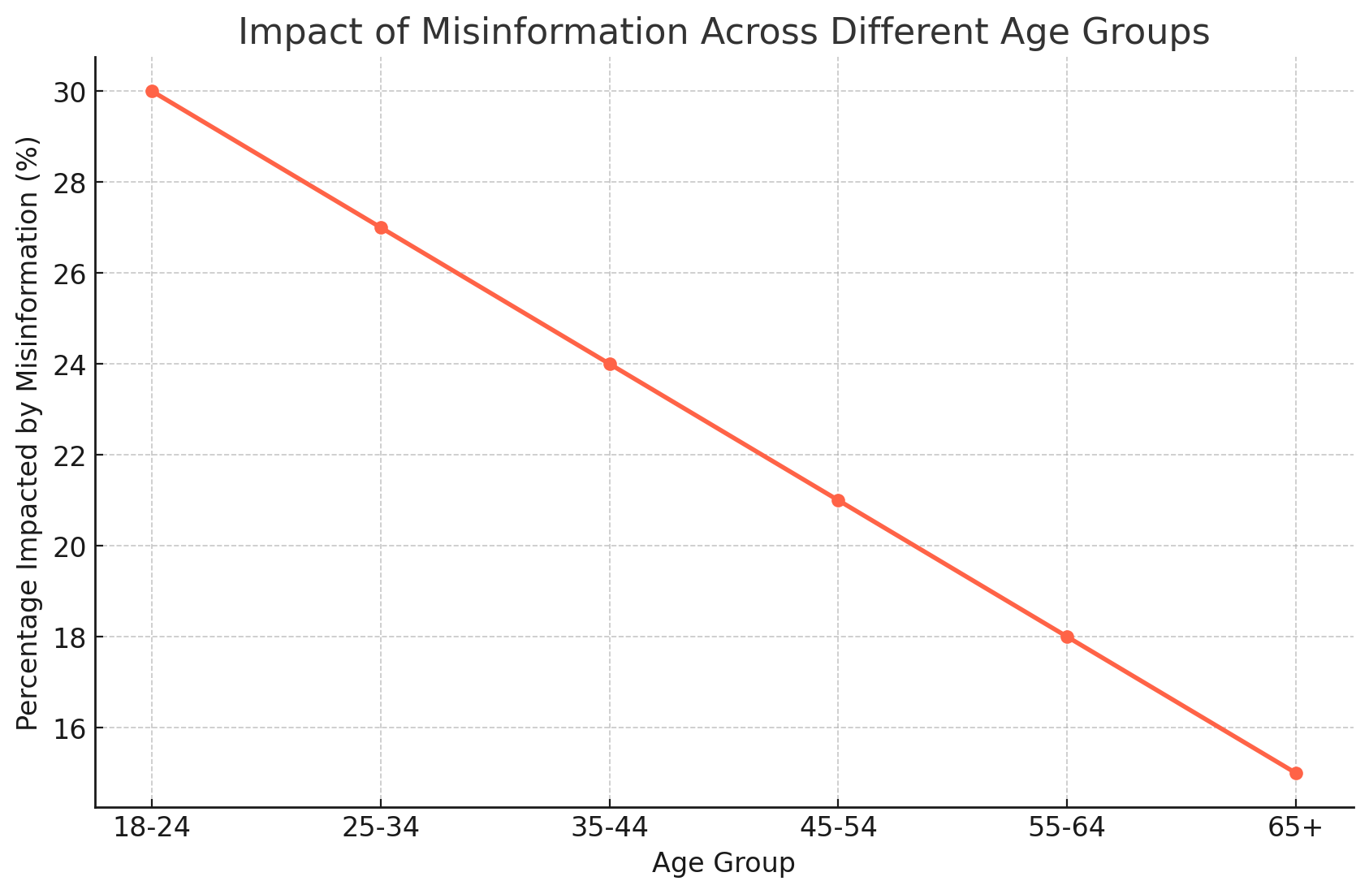
The Echo Chambers of Social Media

Slide 9
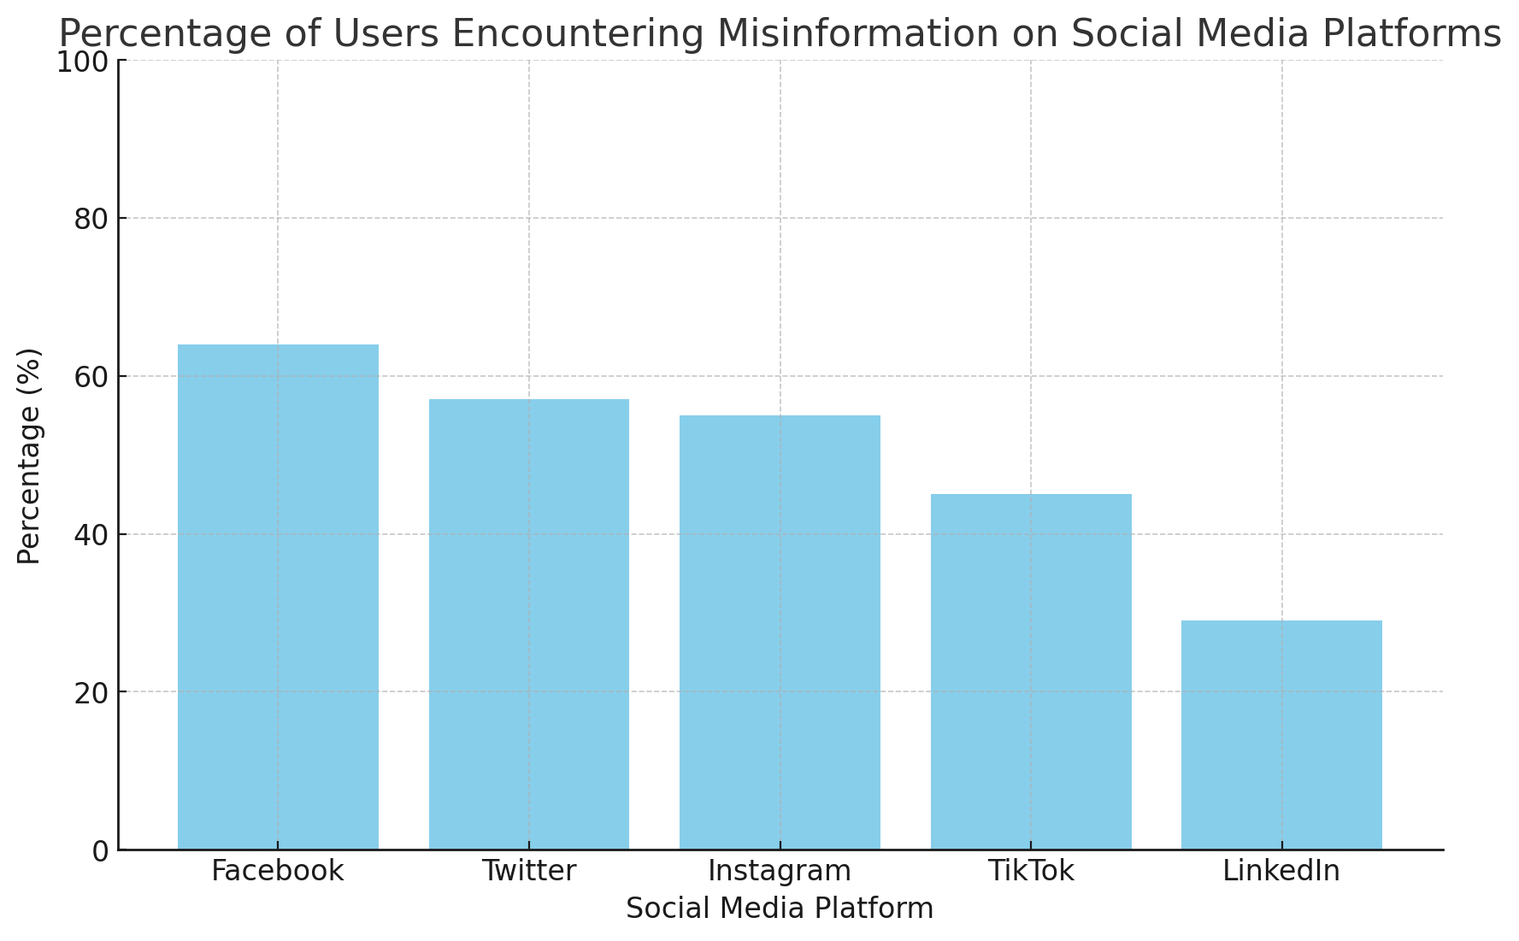
The Carl Sagan Perspective

Slide 10

The End
This presentation explores the complex world of misinformation in the digital age, combining insights from Carl Sagan's work with contemporary issues in social media and AI. It provides a comprehensive view of how misinformation spreads and impacts different demographics, urging the audience to foster a culture of skepticism and truth-seeking in today's information-saturated world.

